Slide 1
NOTE:
Use this presentation as a starter template or as content to include in your parent information sessions.
Customize your deck for your audience with using the alternate title slides and the K-5, 6-12, and social emotional learning course sections included at the end of the presentation.
Feel free to edit, add, and personalize content as needed to fit your program and audience and showcase your program’s unique attributes.

Slide 2


Your Logo Here
Information Session

Slide 3

Your Logo Here
Information Session

Slide 4
About [School Name]
Mission statement here

Slide 5



Who We Serve
Hospitalized or homebound students
At-risk students or students who need credits to graduate
Students with emotional or behavioral needs
Homeschool students
Advanced students who learn at an accelerated pace (gifted, 2E students)
Competitive student athletes and performers
Students in military and traveling families
Students with scheduling conflicts because of work or family obligations
Notes:
If your son or daughter enjoys a non-traditional learning environment, wants a flexible schedule, is ahead or behind in their studies, learns at a different pace than their peers, or wants a more individualized approach to learning, our program featuring Edmentum’s EdOptions Academy may be the answer. These courses allow students to work at their own pace.

Slide 6
About Our Program and EdOptions Academy
Grades Kindergarten through 12
Engaging, self paced learning
Flexible learning schedule – synchronous and asynchronous learning options
Offers parent supports to facilitate K-5 home-based learners
Provides you and your child with personal support from certified teachers who are committed to your student’s success
Strives to create a connection between the home and school so that, with joined efforts, we can help students learn, grow, and achieve
Students remain connected to their in-person school community with the same supports and opportunities including the option to participate in extracurricular activities such as clubs, dances, and sports.

Slide 7

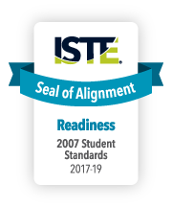




Edmentum’s EdOptions Academy partners with schools and districts across the country to deliver rigorous and research-based curricula built to state and national standards
Notes:
Edmentum is the leader in standards-based online curricula and providing learners with engaging, meaningful online experiences.
Tens of thousands of schools and districts offer Edmentum courses to their students in schools and through virtual learning settings.

Slide 8



EdOptions Academy Courses
Elementary
Middle and
High School
High School +
Project-based learning
Core Subjects, Art, P.E., Music
Supports for guardian to aid student’s day-to-day learning
400+ Courses
Including over 100 semesters of courses in core subject areas, over 100 semesters of CTE offerings, 27 semesters of college prep courses, world languages, and more.
Career preparation in 10 vocational areas, including home-care professional, office management, customer service, hospitality, food services, commercial driving, and more
Notes:
Delete sections according to the catalog your program follows. You can provide a link to the catalog your school will be implementing by visiting our catalog page (https://www.edmentum.com/course-catalog) and selecting the options for your school’s state, grade level and course libraries.

Slide 9
Ongoing Personal Support from
Certified Instructors
EdOptions Academy instructors communicate with you and your child regularly from enrollment through completion and are available when you or your student need support.
Notes:
Your student’s state certified teacher will be available to help answer questions and keep them motivated. Instructors are available via Phone, email, and text.
You as the parent will be able to access student progress and communications through and online student information system.

Slide 10
Customized live 1:1 tutoring available 24/7
Outstanding tutors
    Minimum of a Bachelor’s degree and 2 years experience
Tutoring can be accessed on demand or can be scheduled
Tutoring is personalized for each student
    Academic coaching
    Language support
    Skill building
    Test preparation
  Holistic support to foster open, effective communication
Notes:
Unhide this slide if your implementation has tutoring

Slide 11
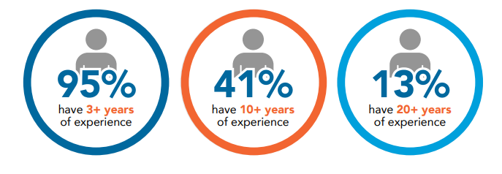
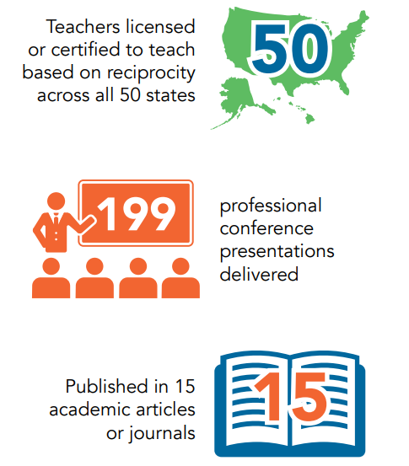
Who Are EdOptions Academy Instructors?
    “
    ”
EdOptions Academy makes it possible for students to have an educational experience that is tailored to their needs and/or preferences.
—Michaela Kenon,
EdOptions Academy Math, German, and CTE Teacher

Slide 12
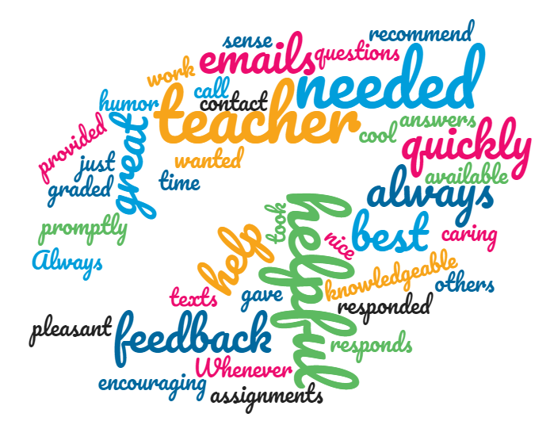
Student Sentiments
“My teacher always provided feedback for my work and was very encouraging for me to do my best.”
95%
Of students feel supported
“Whenever I needed help, I could just call my teacher and she would go through it with me.”
“My teacher wanted the best for me, and she took the time to help me when and if I needed it; she was always in contact.”
Notes:
We hold our teachers to a high standard, and the impact they have on students is big part of that. To maintain quality and to ensure that we are always improving on our ability to meet the needs of all students, we survey our students at the end of each course. Here are just a few quotes that students shared about their teachers.

Slide 13
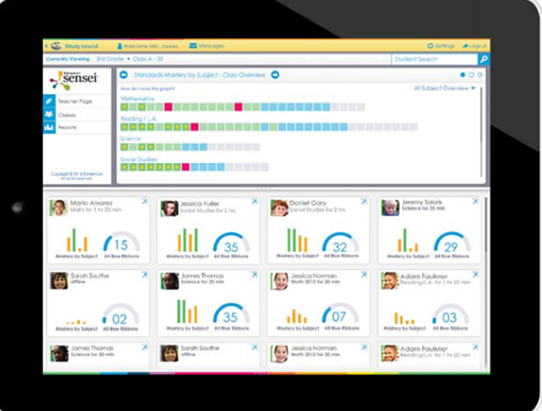
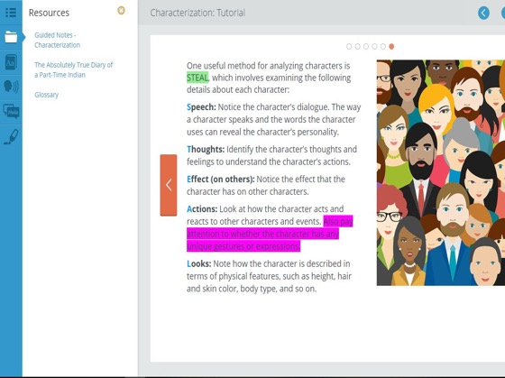
Simple Technology
Lesson Resources,
Including Guided Notes
Dictionary
Click-to-Speak Reading Tools
Translation Tools
Calculator
Highlighter
Notes:
The Student Toolbar is an important part of Edmentum’s in-product commitment to student success. Each tool is designed to promote student engagement and course content retention; student accommodations like translation tools and Click-to-Speak can also be accessed from the Student Toolbar.
Highlighter: The ability to highlight text supports student reading and retention. It also supports learners as they review and study.
Lesson Resources: Lesson Resources feature a glossary of course terminology and Guided Notes. We are currently in the process of adding Guided Notes to more courses.
Guided Notes support student engagement in courses by providing a format to organize, understand, and apply lesson objectives. This can help students retain content better and improve outcomes on mastery tests.
Click to Speak: Many students benefit from the ability to go back and hear things repeated, or visually see sentences and words highlighted while spoken aloud. Click to Speak is another option that makes these learning accommodations available to students.
Translation Tools: Edmentum’s Translation Tools support 18 languages, and offer your English language learners the ability to translate content as needed while progressing toward English language proficiency.

Slide 14
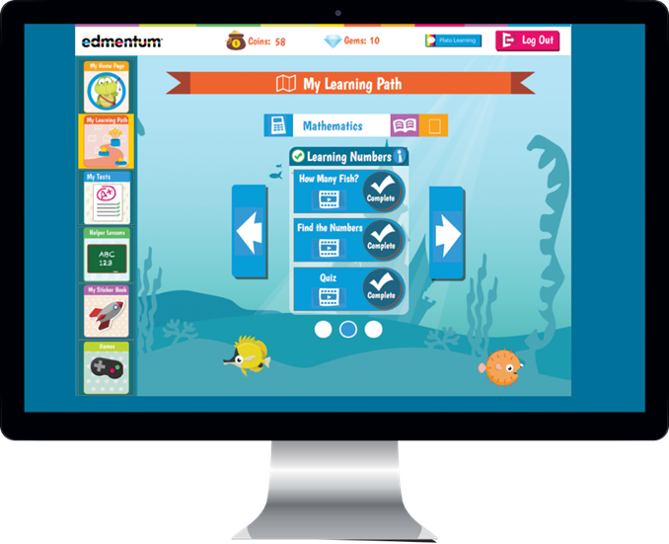
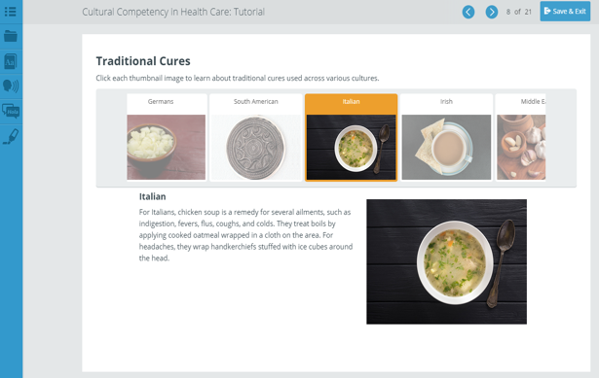
Quality Content: Engaging Content
Students are engaged through an intuitive, easy-to-use learner interface
Content provides students the opportunity to think critically, problem-solve and be creative, practice what they are learning, and acquire new knowledge
Students are presented with relevant, real-world situations; interactive lessons; technology-enhanced items; and animations and videos
Notes:
Rigorous content comes from activities that:
Provide foundational knowledge and illustrate key concepts
Require application of knowledge to real-world situations
Engage students in higher-order thinking
Include assessments that demonstrate deep understanding

Slide 15
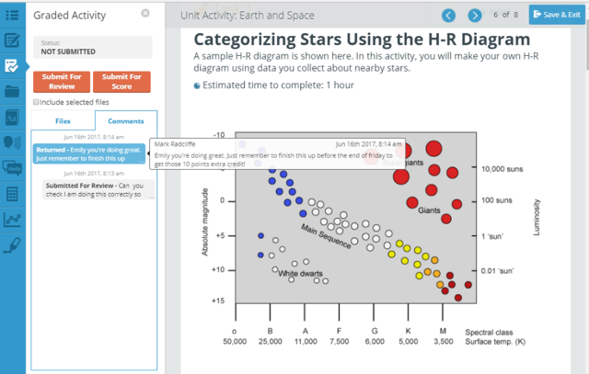
Simple Technology:
Unit and Course Activities
Engaging activities provide rigor in the course and allow students to work at their own pace
Students can submit their work for review, giving educators a chance to provide feedback
A record of all comments and feedback is readily available
Educators are promptly notified once an assignment is submitted
Notes:
Communication is key in any learning environment. With Edmentum’s Unit & Course Activities, students can submit work for review prior to finalization, giving educators the opportunity to read questions or comments from learners on their work in progress and provide feedback while changes can still be made. This allows educators to communicate directly with students within their actual graded activity and creates a record of all comments back and forth.

Slide 16
Questions?

Slide 17
Ready to Enroll?
Enrollment Is Now Open
Call:
Email:
Visit:

Slide 18
Expansive course offering
Rigorous, research-based courses designed to engage students.
100+
Semesters of core curriculum
100+
Semesters of career and technical courses
30
Semesters of world languages
100+
Semesters of electives
12
Semesters of advanced placement courses
Notes:
As with any other aspect of education, at the core of quality content development is a team of knowledgeable and dedicated people. At Edmentum, we are proud to have built a curriculum team of experts in a variety of subjects who have thousands of years in total of combined real classroom teaching and technology experience behind them and who understand what good instructional strategies look like.

Slide 19
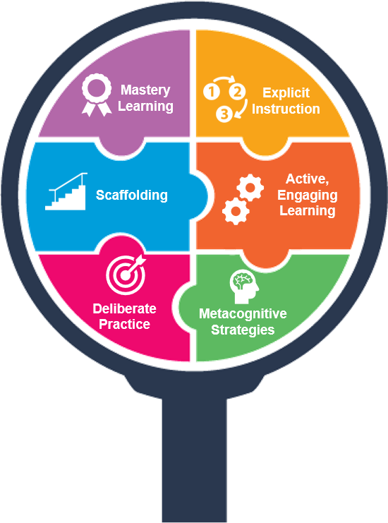
Middle and High School Courses are built using research-based design principals
Mastery Learning
Students show mastery of key content, invest time on not-yet-mastered content, and proceed through learning new content at their own pace.
Explicit Instruction
Support successful learning by providing clear skill statements, modeling of learning outcomes, and reducing cognitive load.
Scaffolding
Buoy learning by providing specific supports when learners need them and systematically removing them—leading to independence as learners approach mastery.
Active, Engaging Learning
Involve learners in responding to and manipulating information while they learn—ensuring their involvement in building understanding and minimizing passive reception of information.
Deliberate Practice
Offer intentional, structured, and sustained practice that builds thoughtfully in complexity to support increasing levels of understanding.
Metacognitive Strategies
Engage students in reflecting on how they best learn and evaluating their thought processes to help themselves along their learning path.

Slide 20


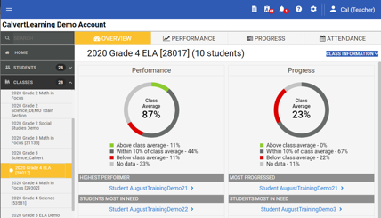
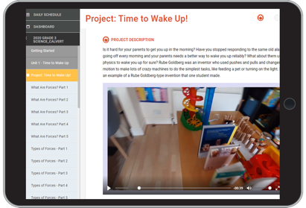
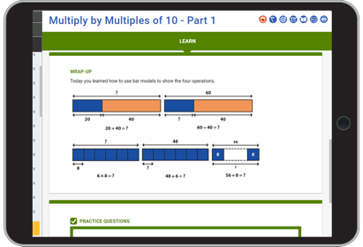
Project-based digital curriculum for K-5
Develop critical thinking skills through high-quality project-based curriculum
Improve learning and retention with research-based curriculum and an intuitive framework
Engage students with a digital experience from anywhere with an Internet connection
Promote lifelong skills including creative problem solving, independent thinking, and the application of knowledge in real-world situations
Notes:
What is Calvert? Calvert is a project-based digital curriculum for K-5 ELA, Math, Science, and Social Studies
Use Calvert as your digital curriculum tool in order to:
Develop critical thinking skills through high-quality project-based curriculum
Engage students with a digital experience from anywhere with an Internet connection
Promote lifelong skills including creative problem solving, independent thinking, and the application of knowledge in real-world situations
Improve learning and retention with research-based curriculum and a cohesive intuitive framework

Slide 21
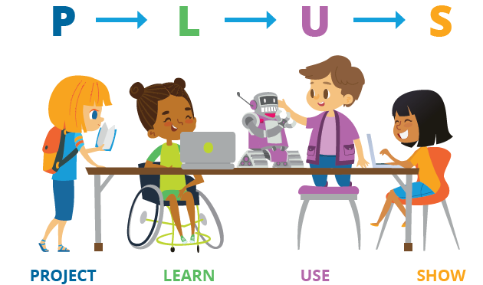
Calvert Learning PLUS Framework
Projects are embedded throughout Calvert courses to give students fun and engaging real-world opportunities to creatively show what they have learned.
Courses contain a variety of active learning activities that encourage students to think independently and formatively assess their understanding.
Students complete mastery assessments at the end of each lesson to ensure that they can use what they have learned and demonstrate mastery.
Students have many opportunities to show what they’ve learned and receive teacher feedback.
Notes:
What is Calvert? Calvert is a project-based digital curriculum for K-5 ELA, Math, Science, and Social Studies
Use Calvert as your digital curriculum tool in order to:
Develop critical thinking skills through high-quality project-based curriculum
Engage students with a digital experience from anywhere with an Internet connection
Promote lifelong skills including creative problem solving, independent thinking, and the application of knowledge in real-world situations
Improve learning and retention with research-based curriculum and a cohesive intuitive framework

Slide 22

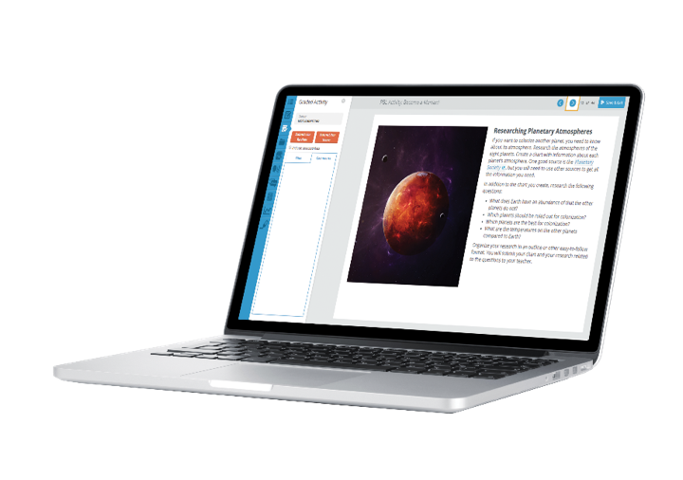
Project-Based Learning (PBL)
Example: “Become a Martian” Activity
Students are asked this essential question, and asked to propose a solution:
How would humans go about choosing another planet to inhabit, and how would they plan for colonization on the chosen planet?
Notes:
By exploring the scientific challenges of colonizing a new planet (e.g., atmosphere, food, impact of gravity) students learn how to conduct and organize research, collaborate as a group, and produce a quality solution proposal.

Slide 23

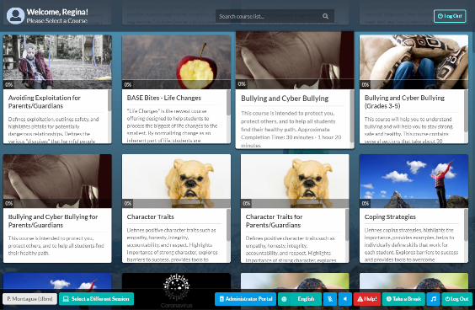


Online SEL Curriculum for grades 3-12
Courses tackle tough topics including Coping Strategies, Digital Citizenship, Bullying, and Equity
Navigate impacts of a changing world
with evidence-based curriculum that creates a safe space for mental health and wellness education
Notes:
All about BASE

